Slide 1
Business Intelligence Solutions for:
Market Flash
Entity Relationship Diagram
Functional Diagram
Database
Data Analytics
Recommendations
spotify
Strategic Dashboard
Sales Dashboard
Operational Dashboard
Recommendations
Business Intelligence Solutions by Anatolij Stopp
Notes:
Good morning/afternoon, everyone, my Name is Anatolij. I got the pleasure to create the Business Intelligence Solution for Market Flash and Spotify.

Slide 2

Market Flash
social media marketing, managing advertising campaigns, influencers, and performance analytics for clients.
Notes:
Market Flash provides social media marketing, manages advertising campaigns,influencers and performance analytics. Markus the owner of Maktet Flash had contacted us and said “Hey, our Data is growing and we can’t manage it in our spreadsheets anymore”.

Slide 3
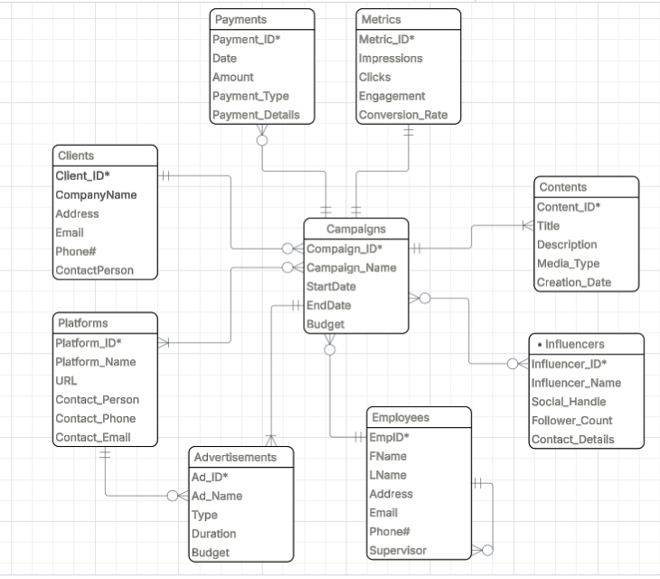
Markt Flash
Entity Relationship Diagram (ERD)
Notes:
After a few successful Sessions with Markus. I was able to create this Entity Relationship Diagram.
Market Flash runs campaigns for clients on platforms with advertisements, manages employees, influencers, and content, tracks metrics, and handles payment transactions.
At this point it became clear that resolving thIs two many-to-many relationships would be necessary in the next phase.

Slide 4
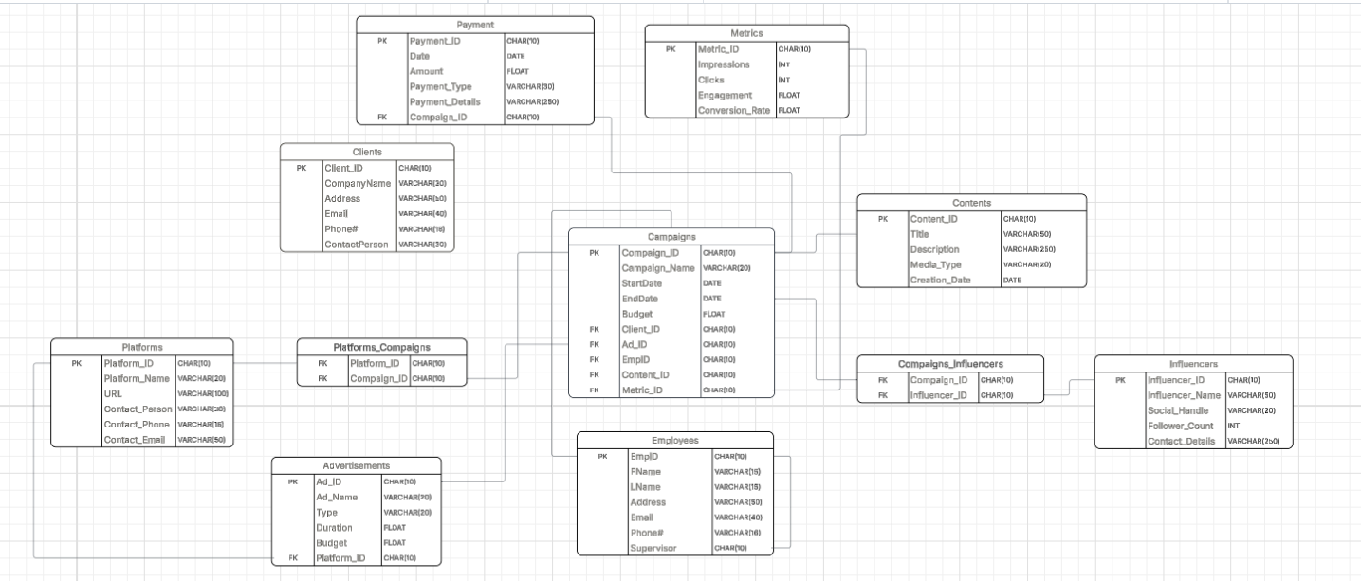
Markt Flash
Functional Diagram
Notes:
In the next phase, the functional diagram was created. The Datatypes were asinged the keys were defined as well further constains. The two m:n relationships were resolved using these two bridge tables.

Slide 5
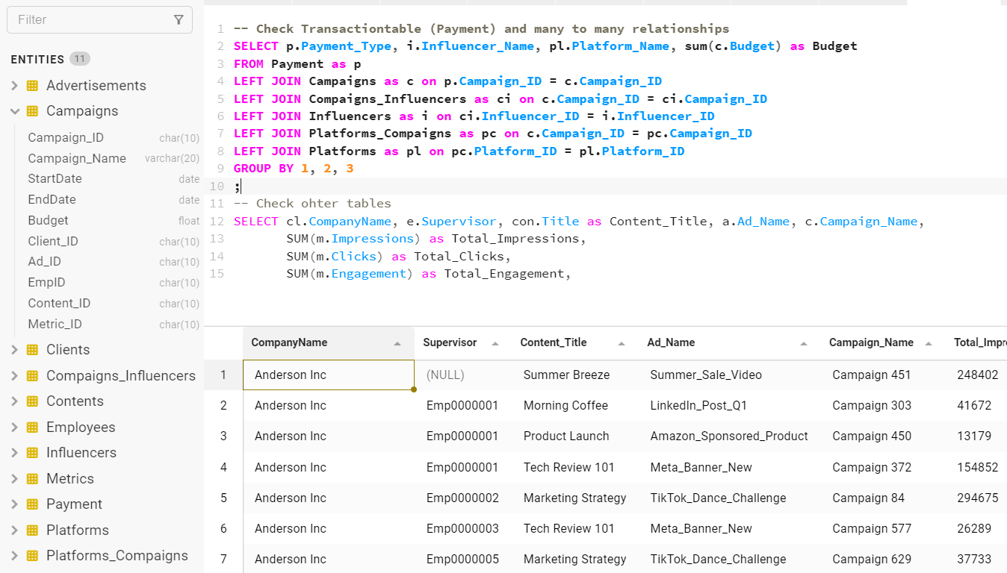
Markt Flash
Database
Notes:
Following the functional diagram, the database was created.
To be able to establish the relationships, it was important to create the tables in the right order. Firstly the Dimetion Tables (like Client, Employees) had to be created, secondly Campang Table as the FactTable with the highest granularity had to be created and lastly the PaymentsTable as the FactTable with the lowest granularity. After Database was created and the Data were inserted, i have tested the Database with this Queries, each table was used and had delivered proper results.
A database offers high scalybility, allowing for easy extension of existing data and the addition of new entities.
For analytics, the database allows tailored retrieval of specific data, which is essential for high-performance reporting.

Slide 6
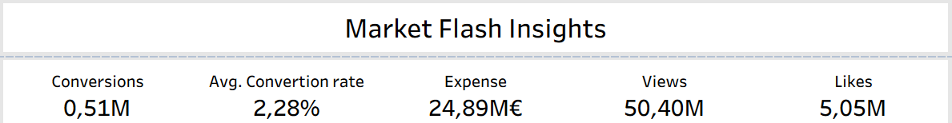
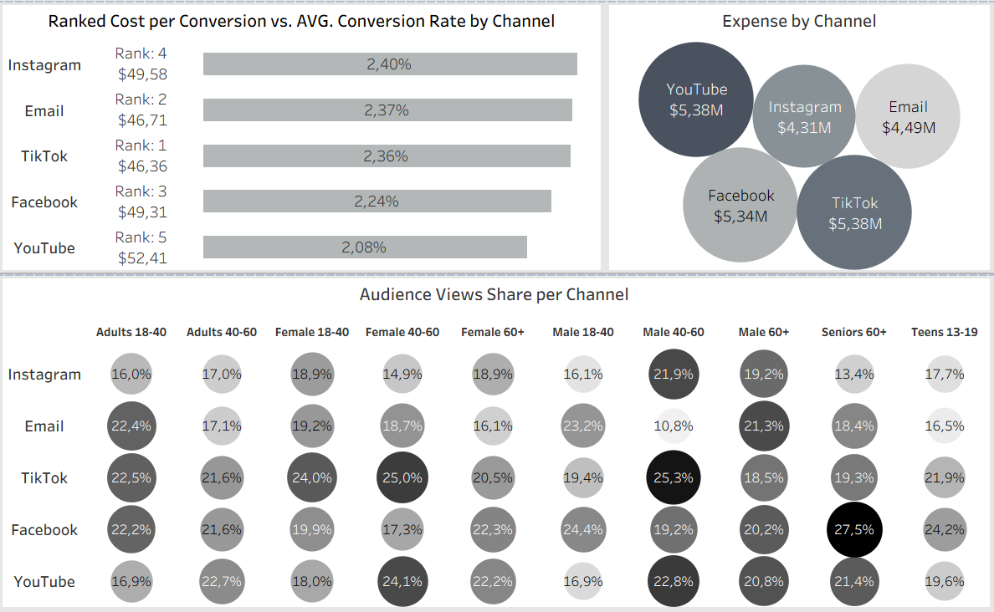
Markt Flash Dashboard

Slide 7
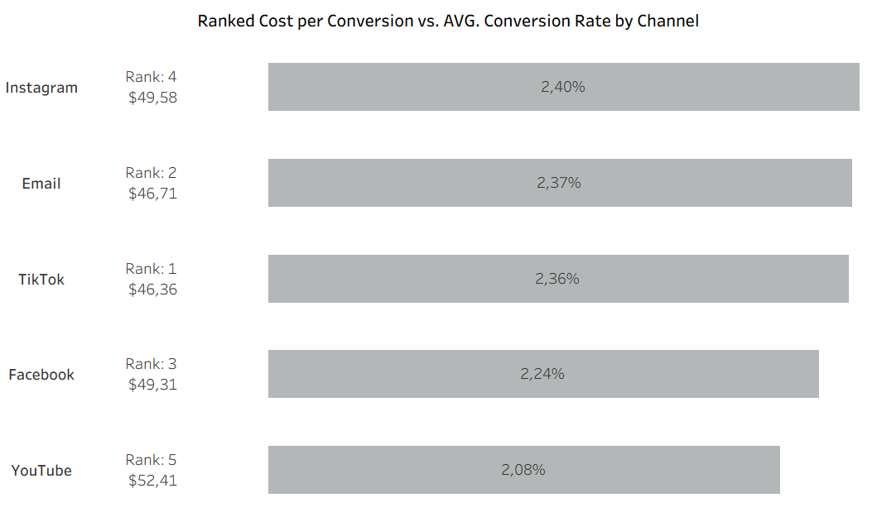
Markt Flash Data most interesting Insights:
The most expensive Channel (YouTube) has the lowest Conversion Rate on average.
.
Notes:
In this data visualization, we can see that YouTube is the most expensive channel with the lowest average conversion rate, while the cheapest channel (TikTok) has the third-best average conversion rate. However, from this perspective, it is difficult to understand which channel performs best or worst.

Slide 8
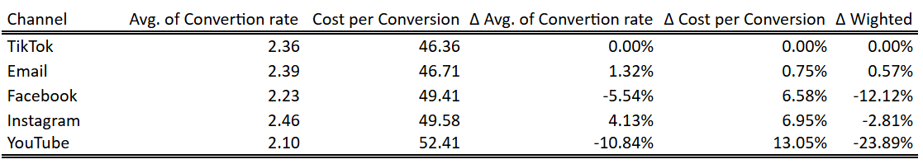
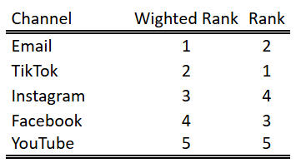
Weighted channel evaluation, based on cheapest Channel (TikTok)

Slide 9
Recommendations
Enrich the data source with Sales and Profit to enable a performance evaluation based on these metrics. Currently, the evaluation is based solely on Cost.
The 'Influencers' table currently contains only two columns describing each influencer. If more columns are required, it is recommended to normalize this table into two separate tables: 'Influencers' and 'Social Handles'.

Slide 10
Q&A
Notes:
Thats all for MarketFlash. I’m happy to answer any questions you may have

Slide 11

Spotify
is one of the world’s largest audio streaming platforms, providing access to over 100 million songs, 7 million podcast titles , and 500k audiobooks.
Notes:
Market Flash provides social media marketing, manages advertising campaigns,influencers and performance analytics. Markus the owner of Maktet Flash had contacted us and said “Hey, our Data is growing and we can’t manage it in our spreadsheets anymore”.

Slide 12
spotifys Request
Strategic Dashboard
long-term growth. With user growth trends for premium and ad users.
Sales Dashboard with detailed breakdown
Revenue for premium- and ad-stream
Premium ARPU
Operational Dashboard with cost structure
cost of revenue,
sales and marketing expenses
research and development costs

Slide 13
spotify Dataset
Quarterly Granularity
17 columns and 26 Rows
One Row was removed
The Total columns were recalculated
The Data had to be unpivoted

Slide 14
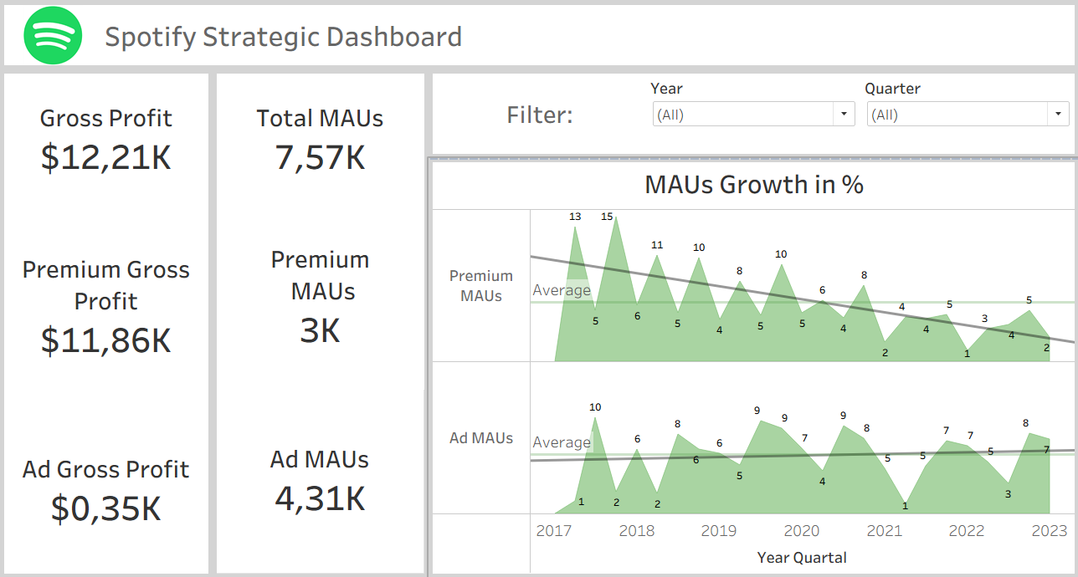
Strategic Dashboard

Slide 15
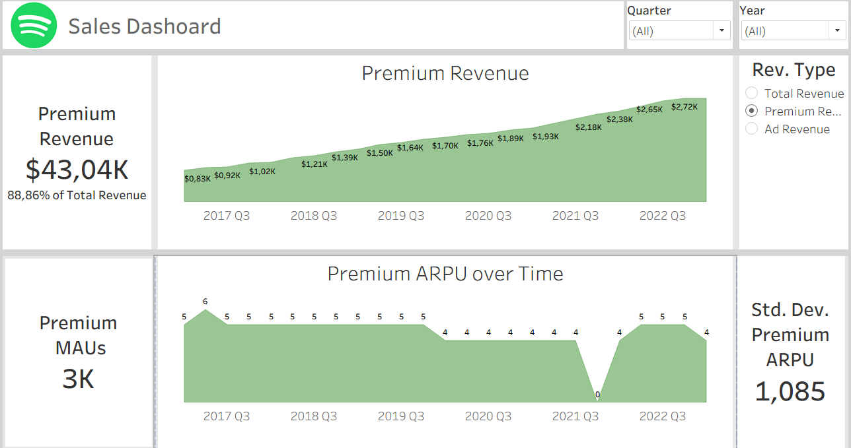
Sales Dashboard

Slide 16
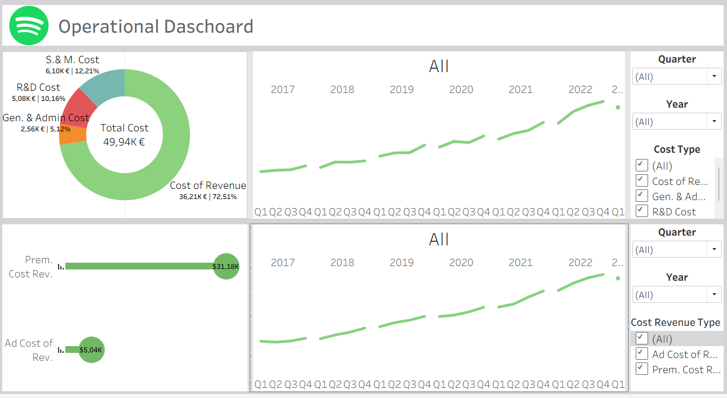
Operational Dashboard

Slide 17
Recommendations
The negative trend in the growth of Premium MAUs lies since Q2_2020 under the AVG growth rate. Define a market target growth rate to be able to compare the current growth rate .
Be aware of the drop in Premium ARPU in Q1_2023, the data shows a similar drop in Q1_2020 and remained for two years.
The combined drop in growth rate and Premium ARPU could mean that the business is at a turning point towards a decline.
As the Ad Cost of Revenue has a high rate of increase over the last three years, it is crucial to understand the underlying causes and mitigate this sharp rise.

Slide 18
Q&A
Notes:
That all for MarketFlash. I’m happy to answer any questions you may have

